Slide 1

Case study Presentation
The Growth of Amazon Using Big Data
& Strategies to Overcome the Current Crisis
Lee Sung HO(이성호) 16102284

Slide 2
- Contents
 - Ⅰ. The purpose of data analysis
 - Ⅱ. Method to solve the problem
 - Ⅲ. Result
 - Ⅳ. Reference

Slide 3

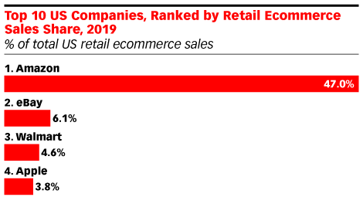
The purpose of data analysis
What is Amazon?
Amazon is known for its disruption of well-established industries through technological innovation and mass scale. It is the world's largest online marketplace, AI assistant provider, and cloud computing platform as measured by revenue and market capitalization. Amazon is the largest Internet company by revenue in the world. It is the second largest private employer in the United States and one of the world's most valuable companies.
Be famous for using Bigdata
Use dynamic pricing policy
Prevent fraud
Company recommend user to buy more

Slide 4

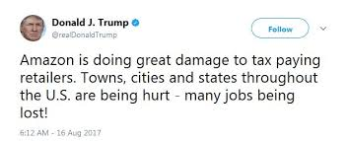
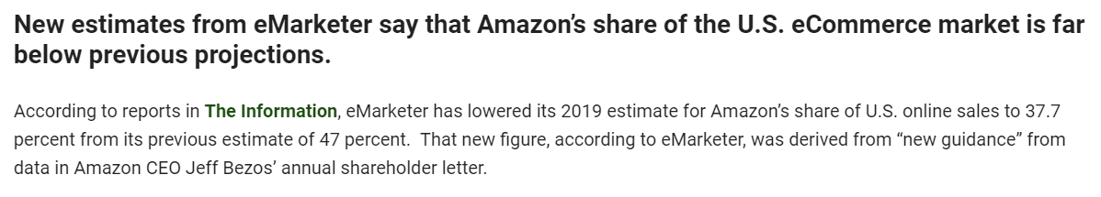


The purpose of data analysis

Slide 5

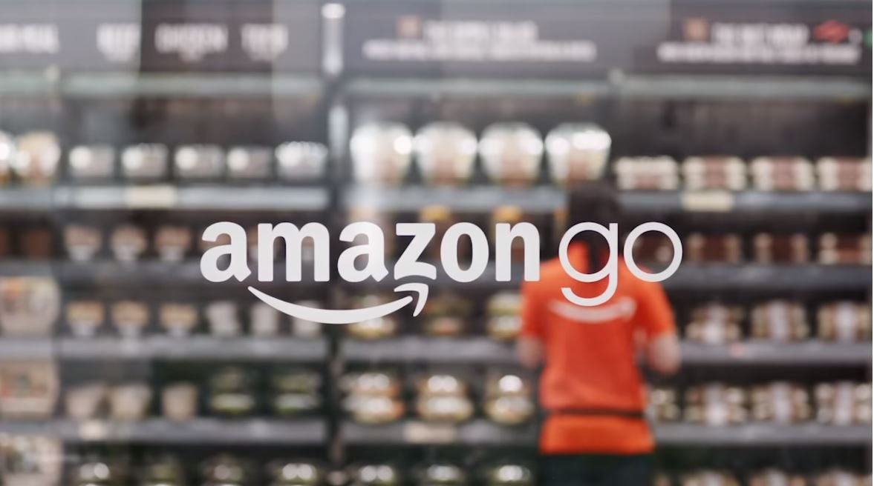
Method to solve the problem
Strategies : Use the data to change offline!
+
M&A WHOLE FOODS
Launch Amazon-Go
Offline Market Entry!

Slide 6
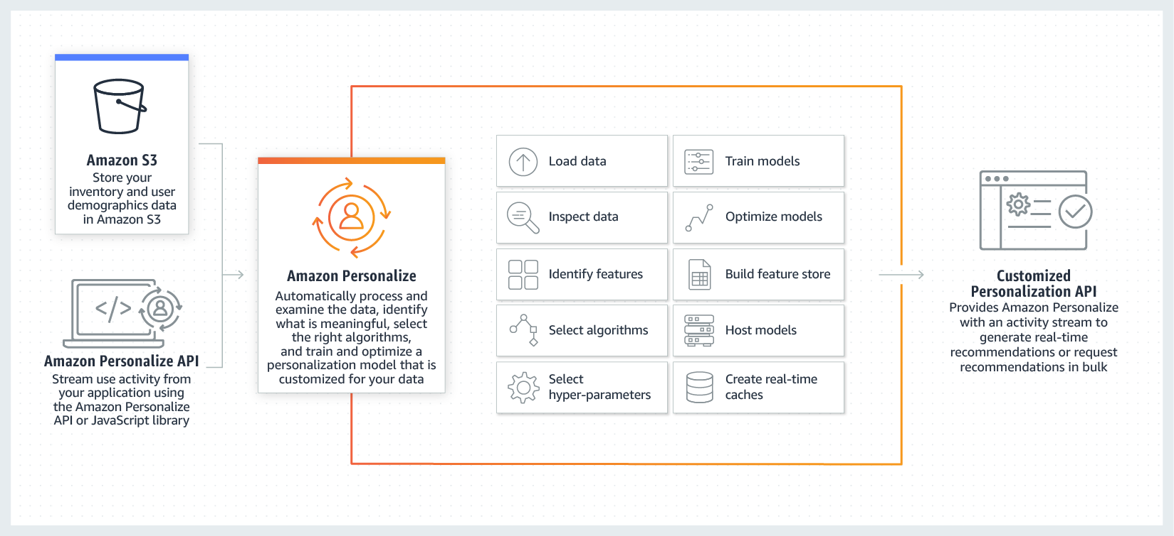
Method to solve the problem
Amazon Personalize

Slide 7



Method to solve the problem
Real-time event transmission
User
Amazon Personalize
Recommendation Results
Recommendation Results
Request Recommendation
Interface query
Server

Slide 8

Result
Launch 3,000 offline Amazon-Go stores
-> $4.5 billion projected return
Collects location data for consumers
-> Identify when and why consumers
are causing behavioral changes
->Assumes consumers who may undergo
similar behavioral transformations by
multi-variable analysis and recommends
products
Amazon CEO, Jeff Vessos

Slide 9
Ⅳ. Reference
https://insidebigdata.com/2019/11/30/how-amazon-used-big-data-to-rule-e-commerce/
https://www.pymnts.com/amazon/2019/amazon-share-ecommerce/
https://aws.amazon.com/ko/personalize/
https://ko.wikipedia.org/wiki/%EC%95%84%EB%A7%88%EC%A1%B4_(%EA%B8%B0%EC%97%85)

Slide 10
Thank you

